Slide 1
SAP Cloud Integration (CI)
September 2023

Slide 2
Agenda
SAP Cloud Integration (CI) Overview
Key Features
Software Update
Architecture
Web UI Components: Discover, Design, Operate and Monitor
Adapters
References

Slide 3
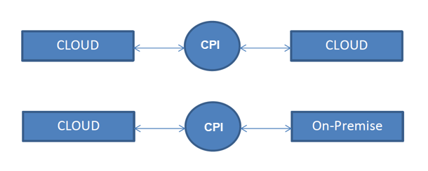
SAP Cloud Integration (CI) Overview
SAP Cloud Integration (CI) helps you to connect cloud and on-premise applications with other SAP and non-SAP cloud and on-premise applications. This service has the capabilities to process messages in real-time scenarios spanning different companies, organizations, or departments within one organization.
SAP Cloud Integration supports end-to-end process integration across cloud-based and on-premise applications (cloud-cloud and cloud-on-premise integration).
.

Slide 4
Key Features
Implement diverse scenarios:
Integrate processes and data in application-to-application (A2A) and business-to-business (B2B) scenarios.
Connect to multiple endpoints :
Integrate various applications and data sources from SAP and non-SAP, on premise, as well as the cloud. SAP Cloud Integration comes with a set of prebuilt adapters.
Customize SAP integration scenarios :
Benefit from prepackaged integration content to jump-start integration projects and to set up productive scenarios with only minimum effort. You can extend predefined integration flows according to your requirements.
Develop custom adapters :
Use the adapter SDK to build your own custom adapters for additional connectivity needs.

Slide 5
Key Features
Out-of-the-box connectivity support (for example, IDoc, SFTP, SOAP/HTTPS, SuccessFactors, OData, HTTPS)
Security features such as content encryption and certificate-based communication
Leveraging preconfigured integration patterns. These integration patterns provide different options for configuring the data flow between participants, for example, by using routing rules.
Core runtime for processing, transformation, and routing of messages to be exchanged between the involved customer systems. It is ensured that data related to different customers connected to Cloud Integration is isolated. This is important, for example, when using Cloud Integration for business-to-business scenarios.

Slide 6
Software Update
The software is updated monthly by SAP.
The following applies for software updates:
Software updates are performed by SAP. Customers do not have to take any action here.
Software updates do not require any downtime of productive scenarios running on the integration platform.
SAP ensures that deployed integration flows continue running after the update.
In case a tenant is not accessible or shows component failures after an update, SAP is notified by appropriate alert mechanisms and triggers the necessary recovery processes.
If a specific integration flow stops working unnoticed after update, customers are asked to open a ticket under LOD-PI (priority high).

Slide 7
Architecture
SAP Cloud Integration is a cloud-based solution. The tenants are provisioned based on request made. Developers can build integrations in virtualized environments, and focus on enterprise integration patterns, implementation challenges, and leave out the maintenance efforts on the platform.
SAP Cloud Integration Nodes:
Integration nodes are core of SAP Cloud Integration that run on the SAP Business Technology Platform (BTP). Each node is a virtual machine instance. We have two types of nodes, and each node performs a different function
Worker Node
Tenant management Node
A worker node performs all the message processing while a tenant management node functions as a supervisor for the worker nodes. Tenant Management Nodes can bring up worker nodes, ensure it is up and running all the time, and keeps a repository of all your integration artifacts.

Slide 8
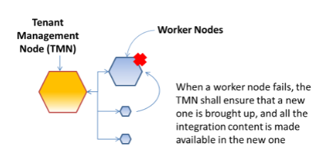
Architecture – Fail Over Capability
SAP Cloud Integration can detect failures, gracefully handle failures, bring up new instances and redirect traffic from a downed instance to a live instance. The tenant management node supervises the worker nodes and shall immediately know if a worker node is not functioning. Health-check reports of worker nodes causes the tenant management nodes to take action.

Slide 9
Architecture - Scalability Capability
We can add additional integration worker nodes and configure to handle the load. The BigIP load balancer shall spread the load between all the instances.
There are two levels of scalability for a worker node.
Increase the VM size of the worker node
Increase the number of worker nodes
SAP Cloud Integration currently provides the following Virtual Machine configurations:
Lite = 1 Core / 2GB RAM
Professional = 2 Cores / 4GB RAM
Premium = 4 Cores / 8 GB RAM
Premium Plus = 8 Cores / 16 GB RAM, available in "à la carte" configurations.

Slide 10
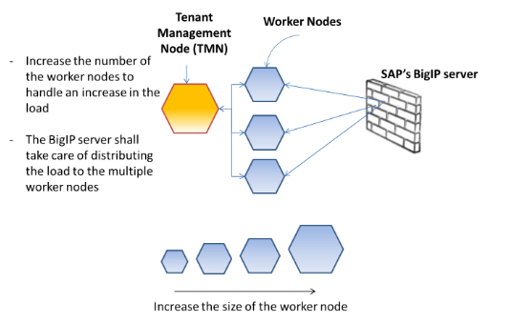
Architecture - Scalability Capability
By default, standard edition of SAP Cloud Integration provides a VM Lite version and one instance of the worker node. You can opt for a higher version of the VM and for more VMs.

Slide 11
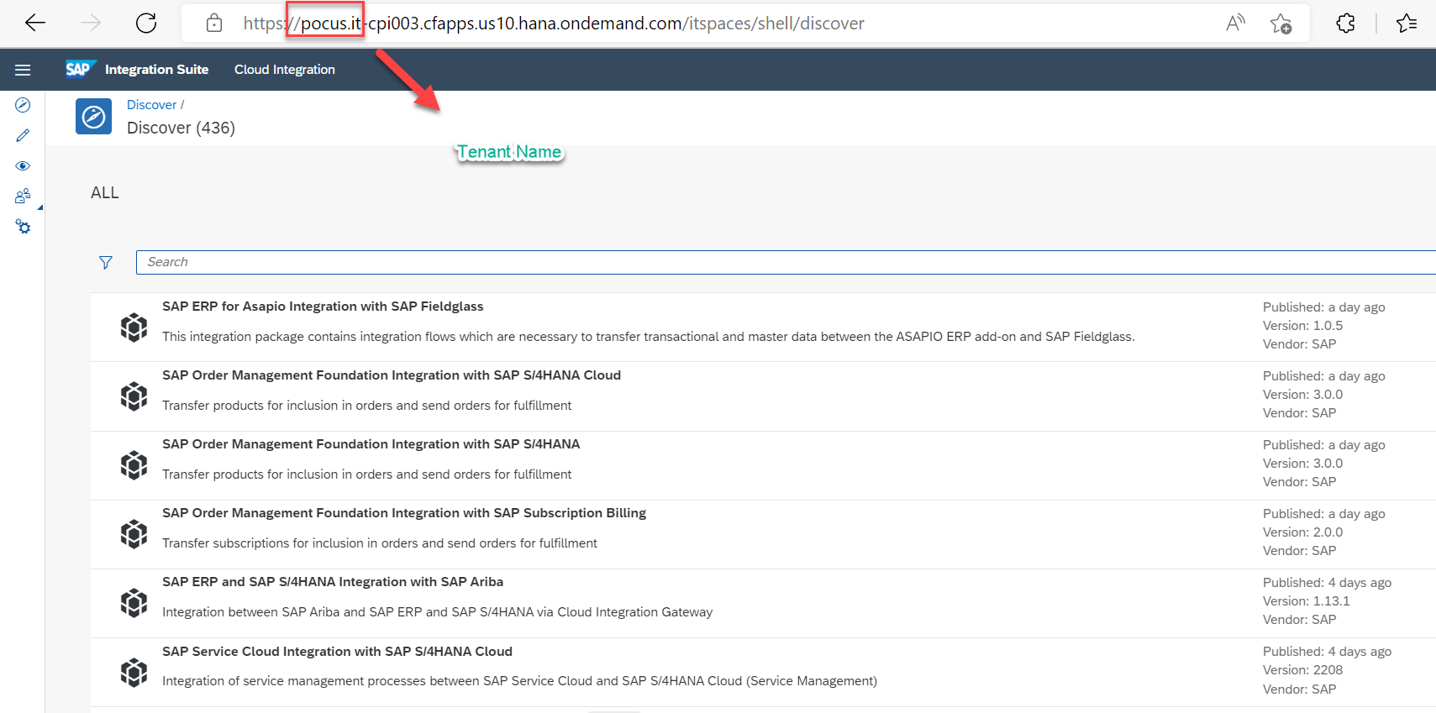
SAP Cloud Integration- Home Page
https://<TenantId>-<HostName>/itspaces/shell/discover

Slide 12
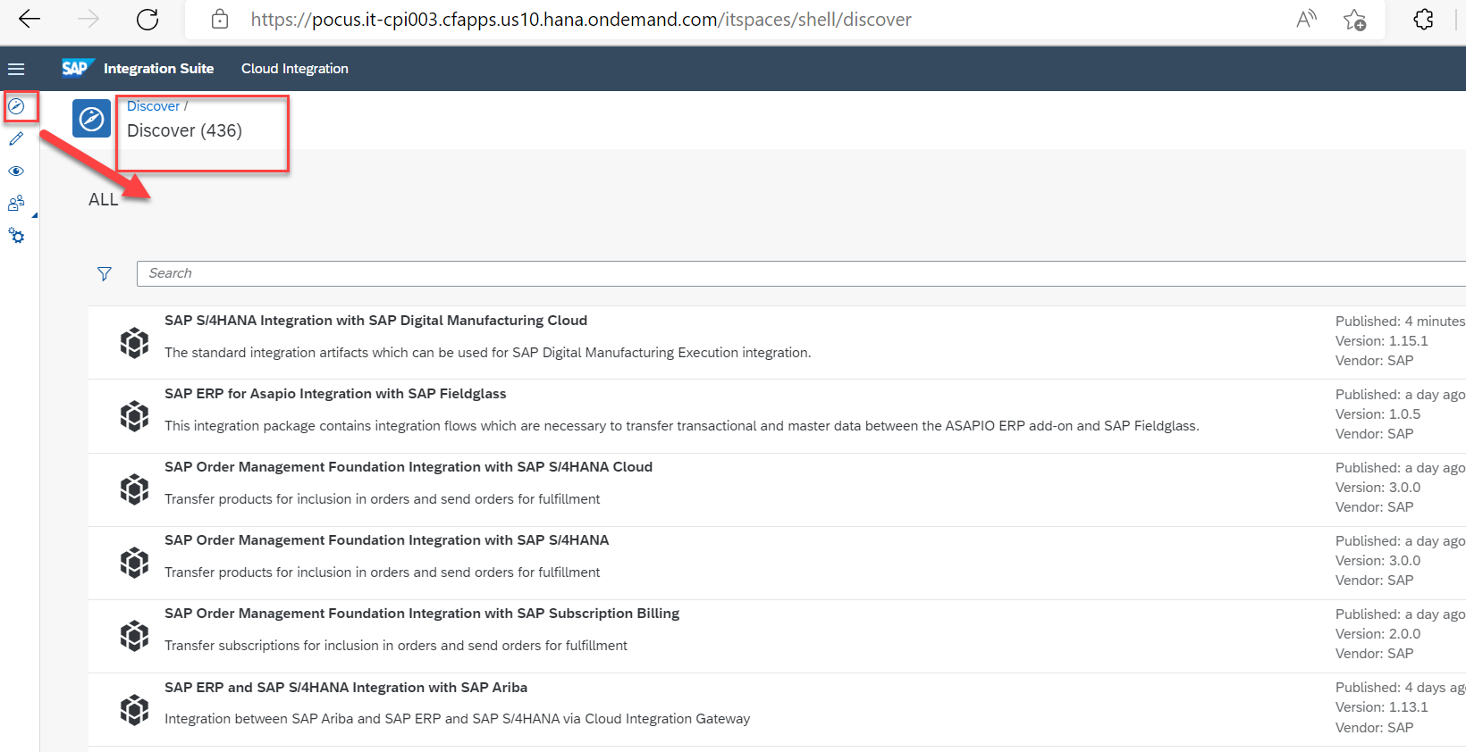
SAP Cloud Integration- Discover page
SAP Cloud Integration provides a starting point for Integration Projects by offering pre-packaged Integration Content
The integration flows in the pre-packaged content are mostly pre-configured and require very minimal configuration to be used in productive scenario.

Slide 13
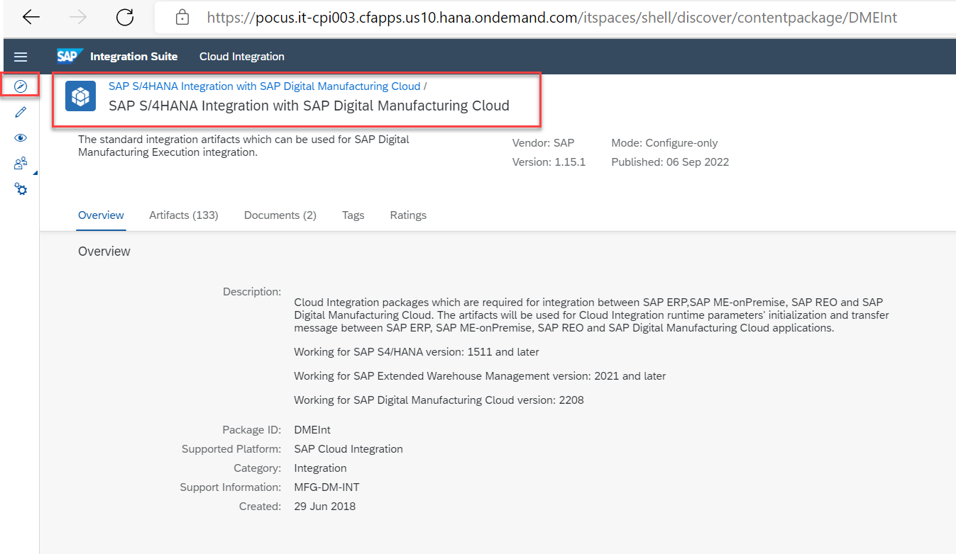
SAP Cloud Integration: Standard Content
An Integration Developer must copy the pre-packaged solution to the tenant. Once the artifact is copied successfully, we can see it under the Design tab and next time onwards we can make changes to the iFlow configuration and deploy it from this tab itself.

Slide 14
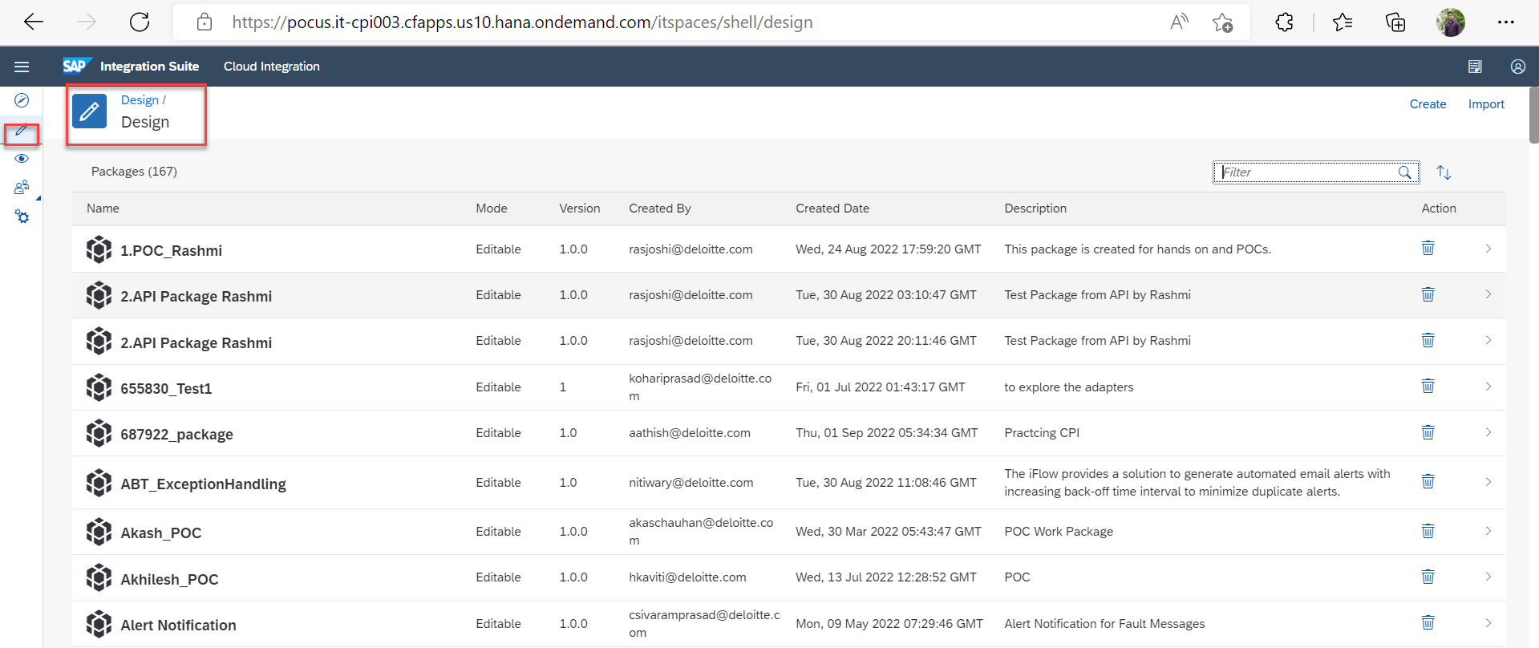
SAP Cloud Integration: Design page
Integration Package with its contents is shown below. To edit, configure and deploy content via web ui the role AuthGroup.IntegrationDeveloper, is required for the specific tenant.

Slide 15
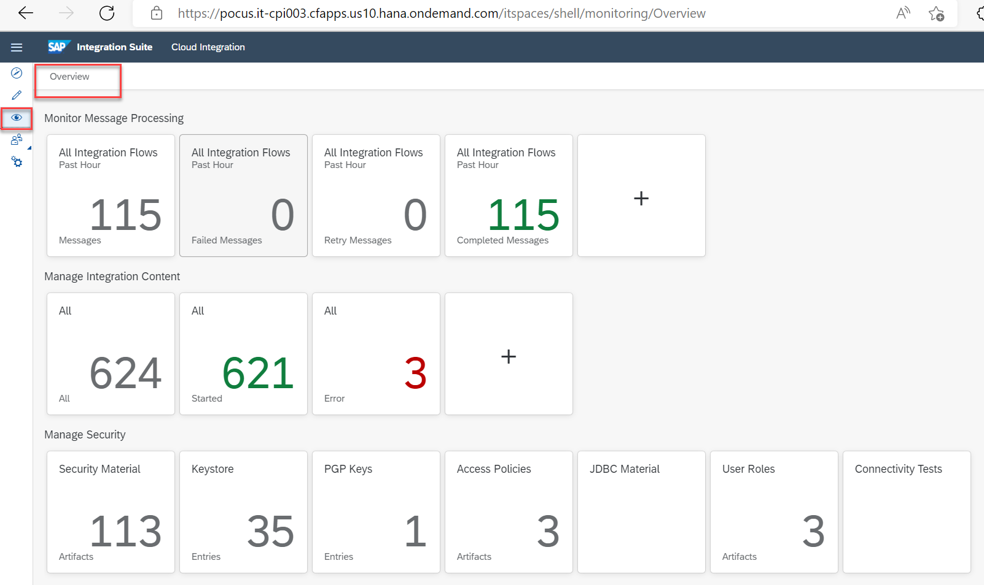
SAP Cloud Integration: Operate and Monitor
Under Overview tab, we can monitor the runtime status for all the deployed artifacts as well as Messages
We can also manage the Security content such as User Credentials, Keystore, SSL certificates etc..

Slide 16
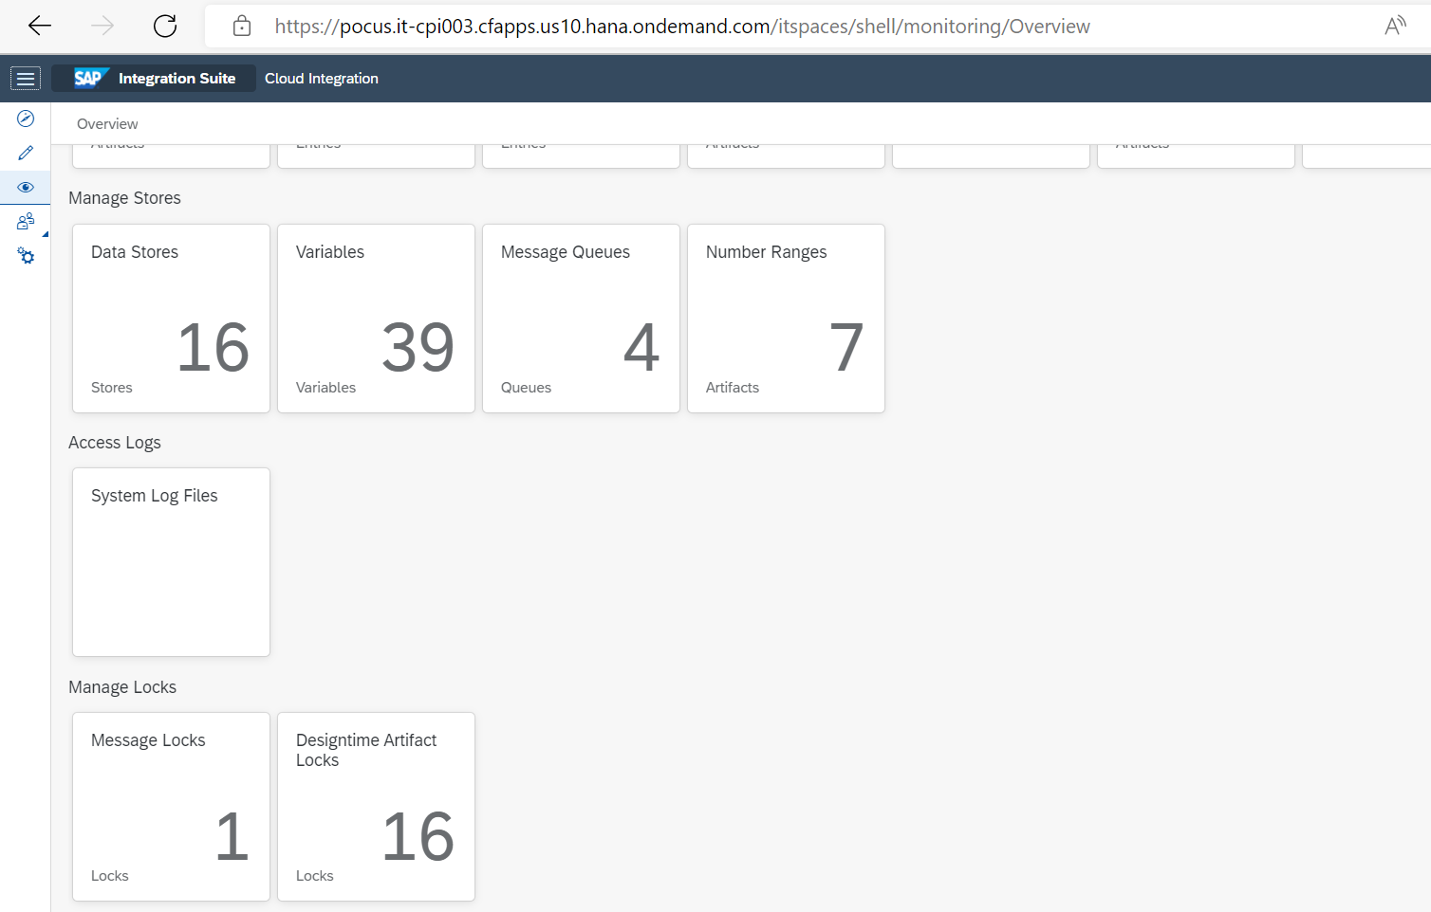
SAP Cloud Integration: Operate and Monitor
Under Manage stores, We can monitor Data stores, Variables, Messages Queues and Number ranges etc.

Slide 17
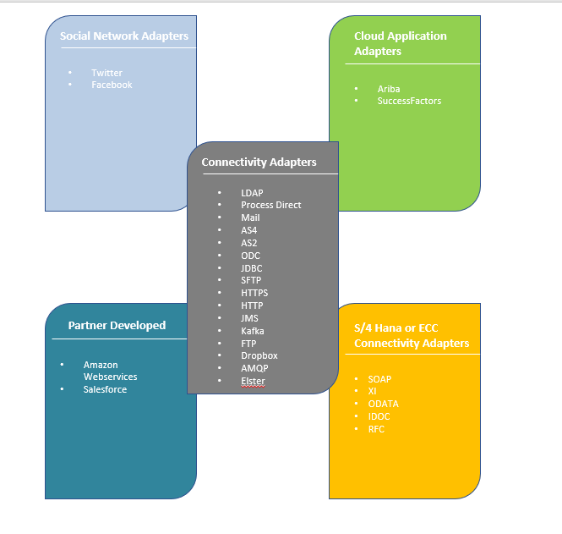
SAP Cloud Integration: Adapters

Slide 18
References
https://help.sap.com/docs/CLOUD_INTEGRATION/368c481cd6954bdfa5d0435479fd4eaf/e12c09cc8e9b4574b092d8964b049ce6.html
https://blogs.sap.com/2015/01/13/architectural-overview-of-sap-hana-cloud-integration/
https://blogs.sap.com/2020/01/16/comprehensive-sap-cpi-development-standards-best-practices/
https://blogs.sap.com/tags/67837800100800006801/
https://blogs.sap.com/tags/73554900100800003241/

Slide 19

About Deloitte Deloitte refers to one or more of Deloitte Touche Tohmatsu Limited, a UK private company limited by guarantee, and its network of member firms, each of which is a legally separate and independent entity. Please see www.deloitte.com/about for a detailed description of the legal structure of Deloitte Touche Tohmatsu Limited and its member firms. Please see www.deloitte.com/us/about for a detailed description of the legal structure of Deloitte LLP and its subsidiaries. Certain services may not be available to attest clients under the rules and regulations of public accounting. Copyright © 2013 Deloitte Development LLC. All rights reserved. 36 USC 220506 Member of Deloitte Touche Tohmatsu Limited
Notes:
18

